Slide 1
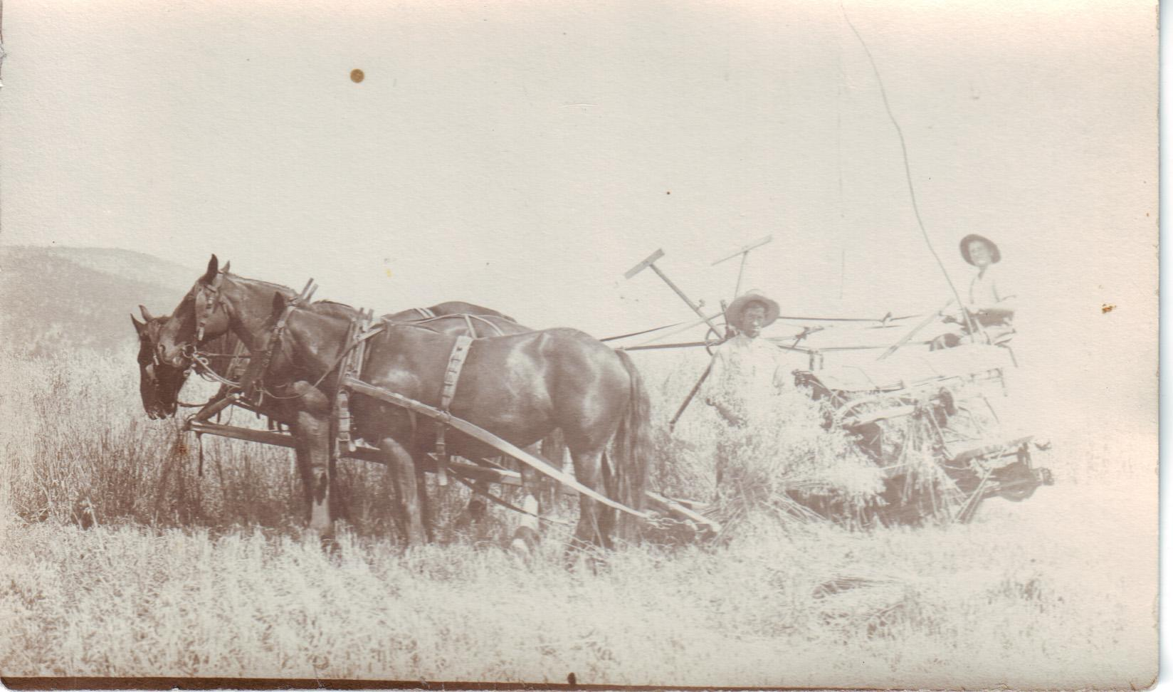
Farms in the Okanagan

Slide 3
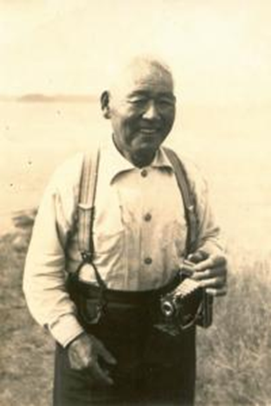
Eijiro Koyama, the Father of Meiri (Koyama) Itami

Slide 4
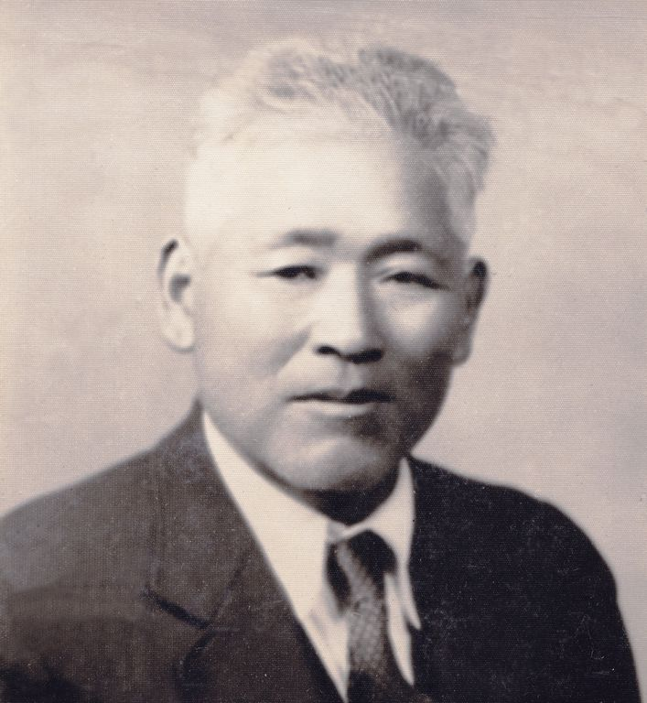
Eijiro Koyama, the Father of Meiri (Koyama) Itami

Slide 5
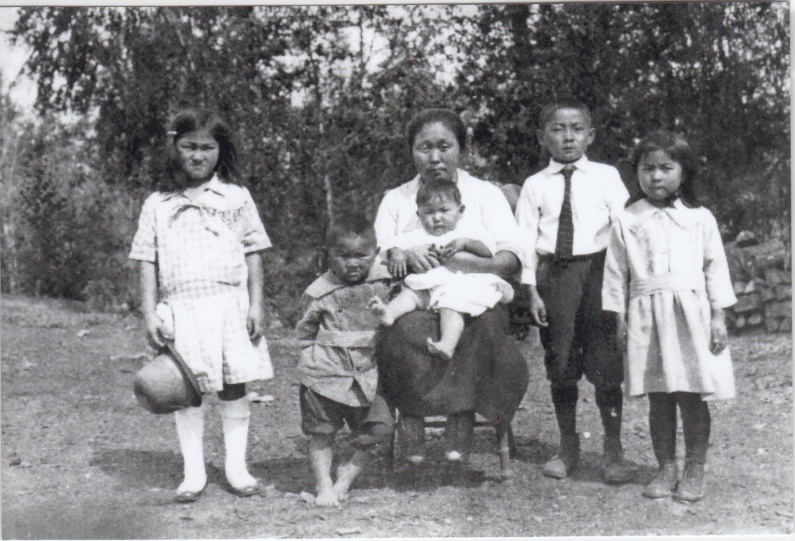
Meiri Itami, the author of the poem, is the baby in the center!
Notes:
Left to Right...Harue Taguchi (Koyama), Motoi Koyama, Fumi Koyama, Meiri Itami (Koyama), Tetsuji( Ted) Koyama and Jean Koybayashi (Koyama).

Slide 6
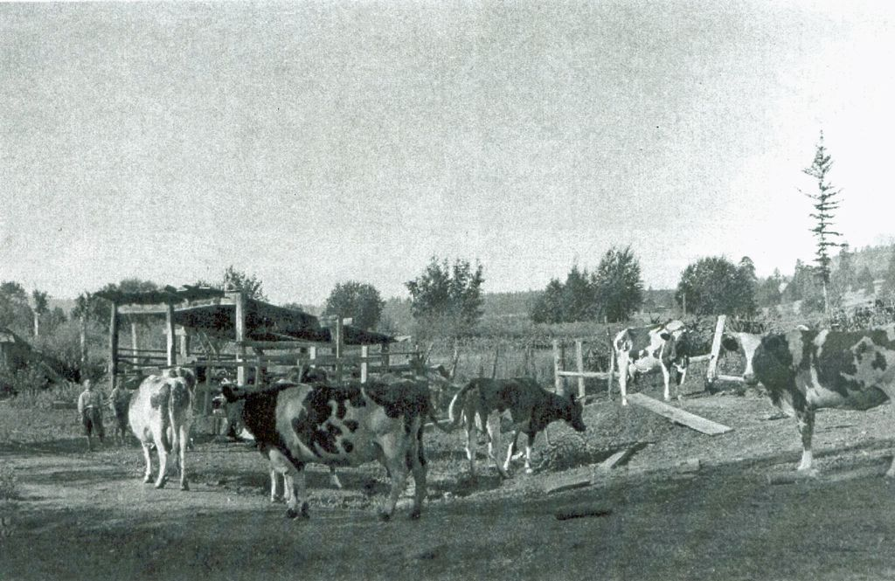
Koyama Farm

Slide 7
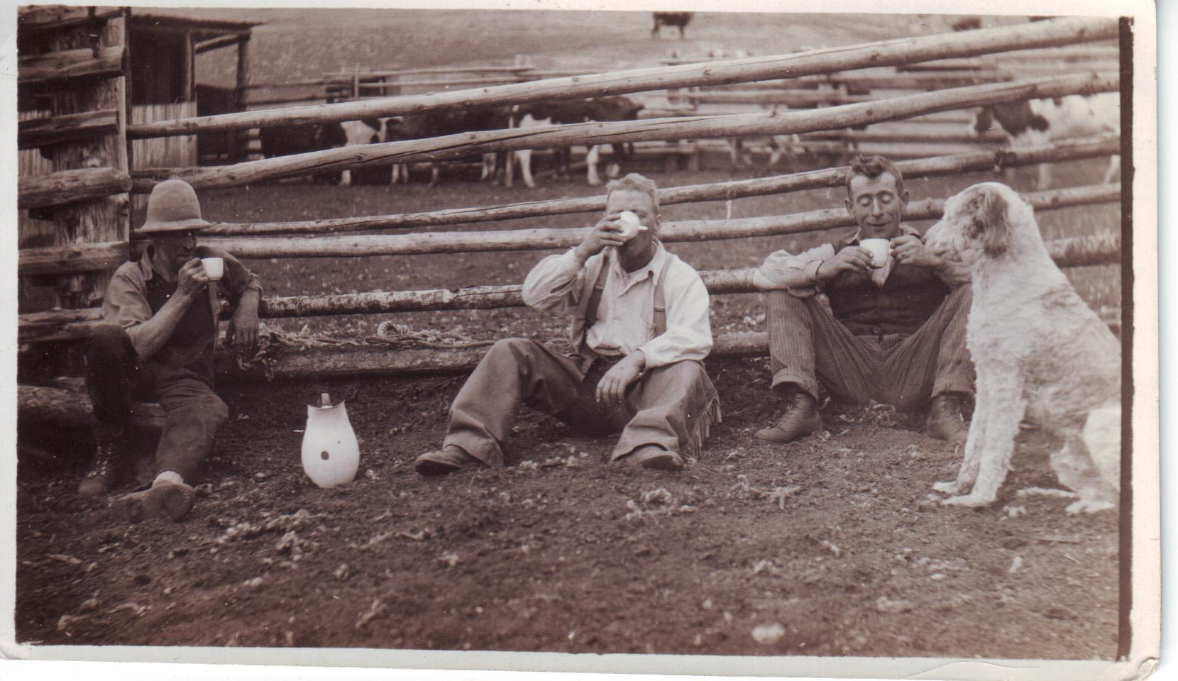
Break time at MP Williams Ranch

Slide 8
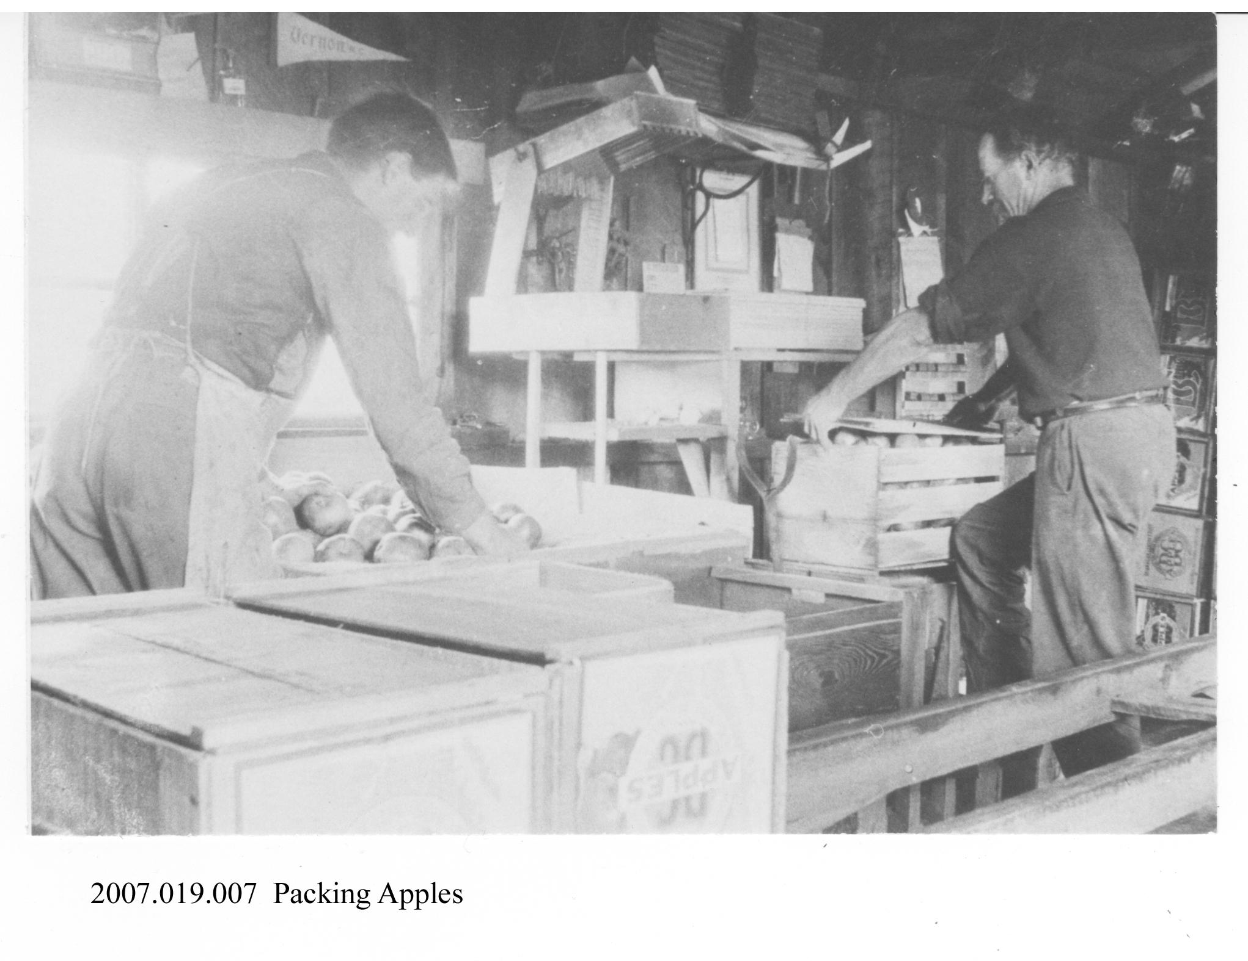

Slide 9
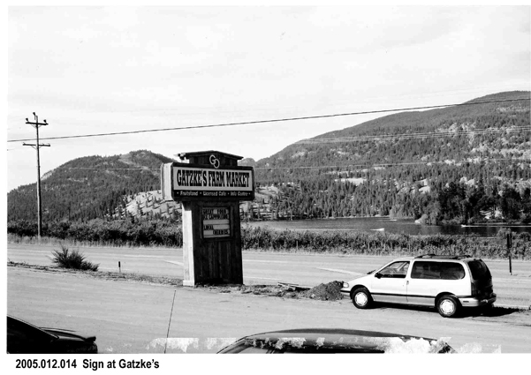

Slide 10
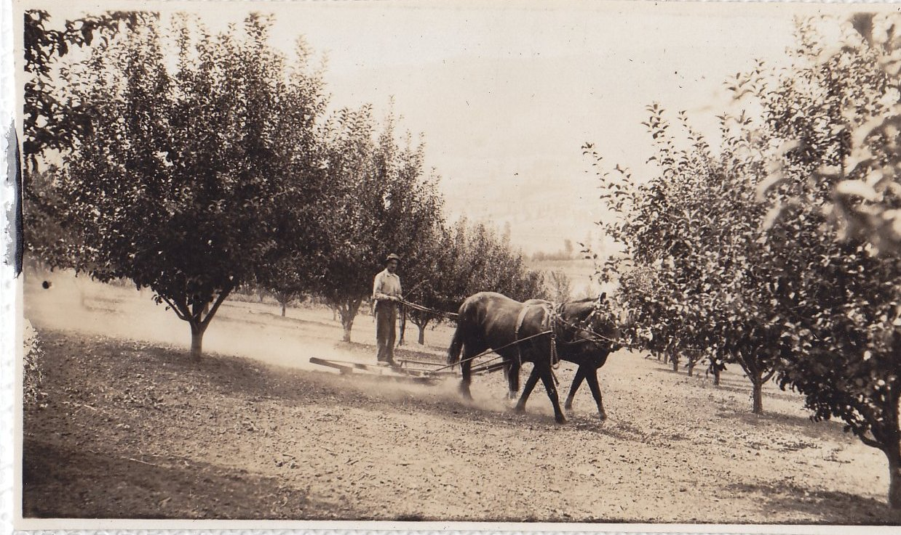
Orchard Maintenance

Slide 11
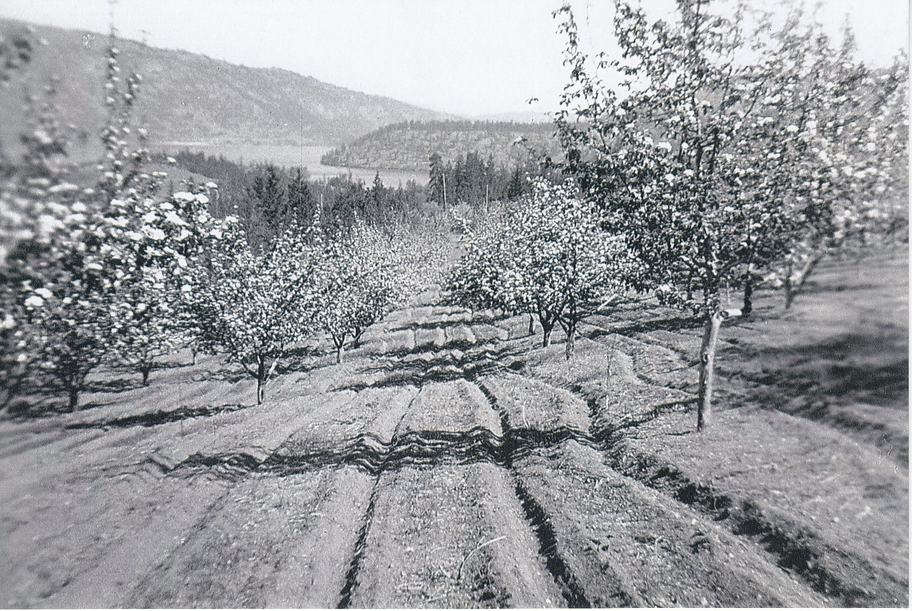
Ploughed fields at Dewar Farm

Slide 12
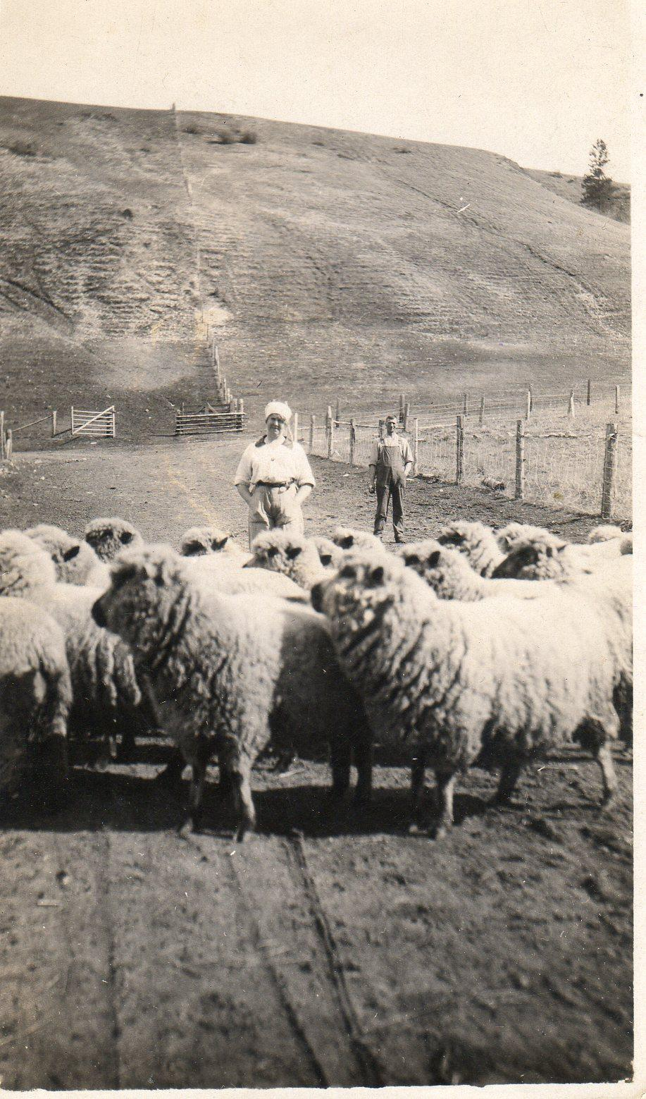
Sheep on the Farm

Slide 13
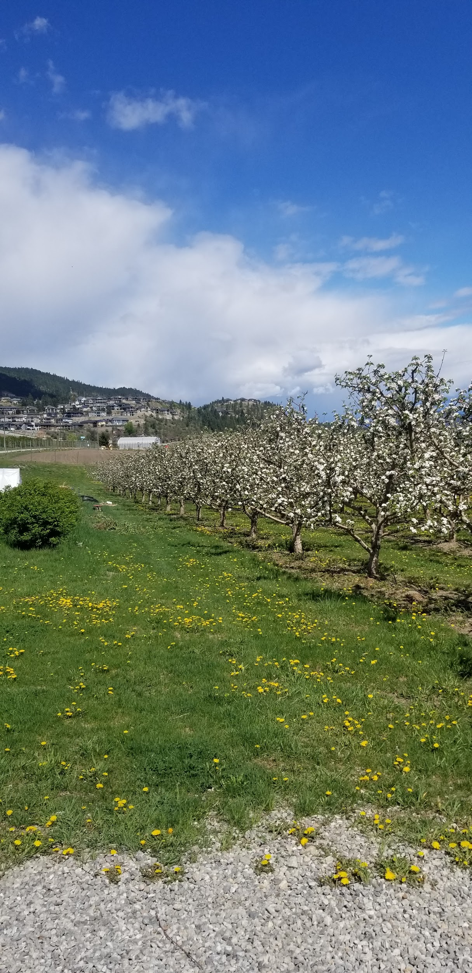
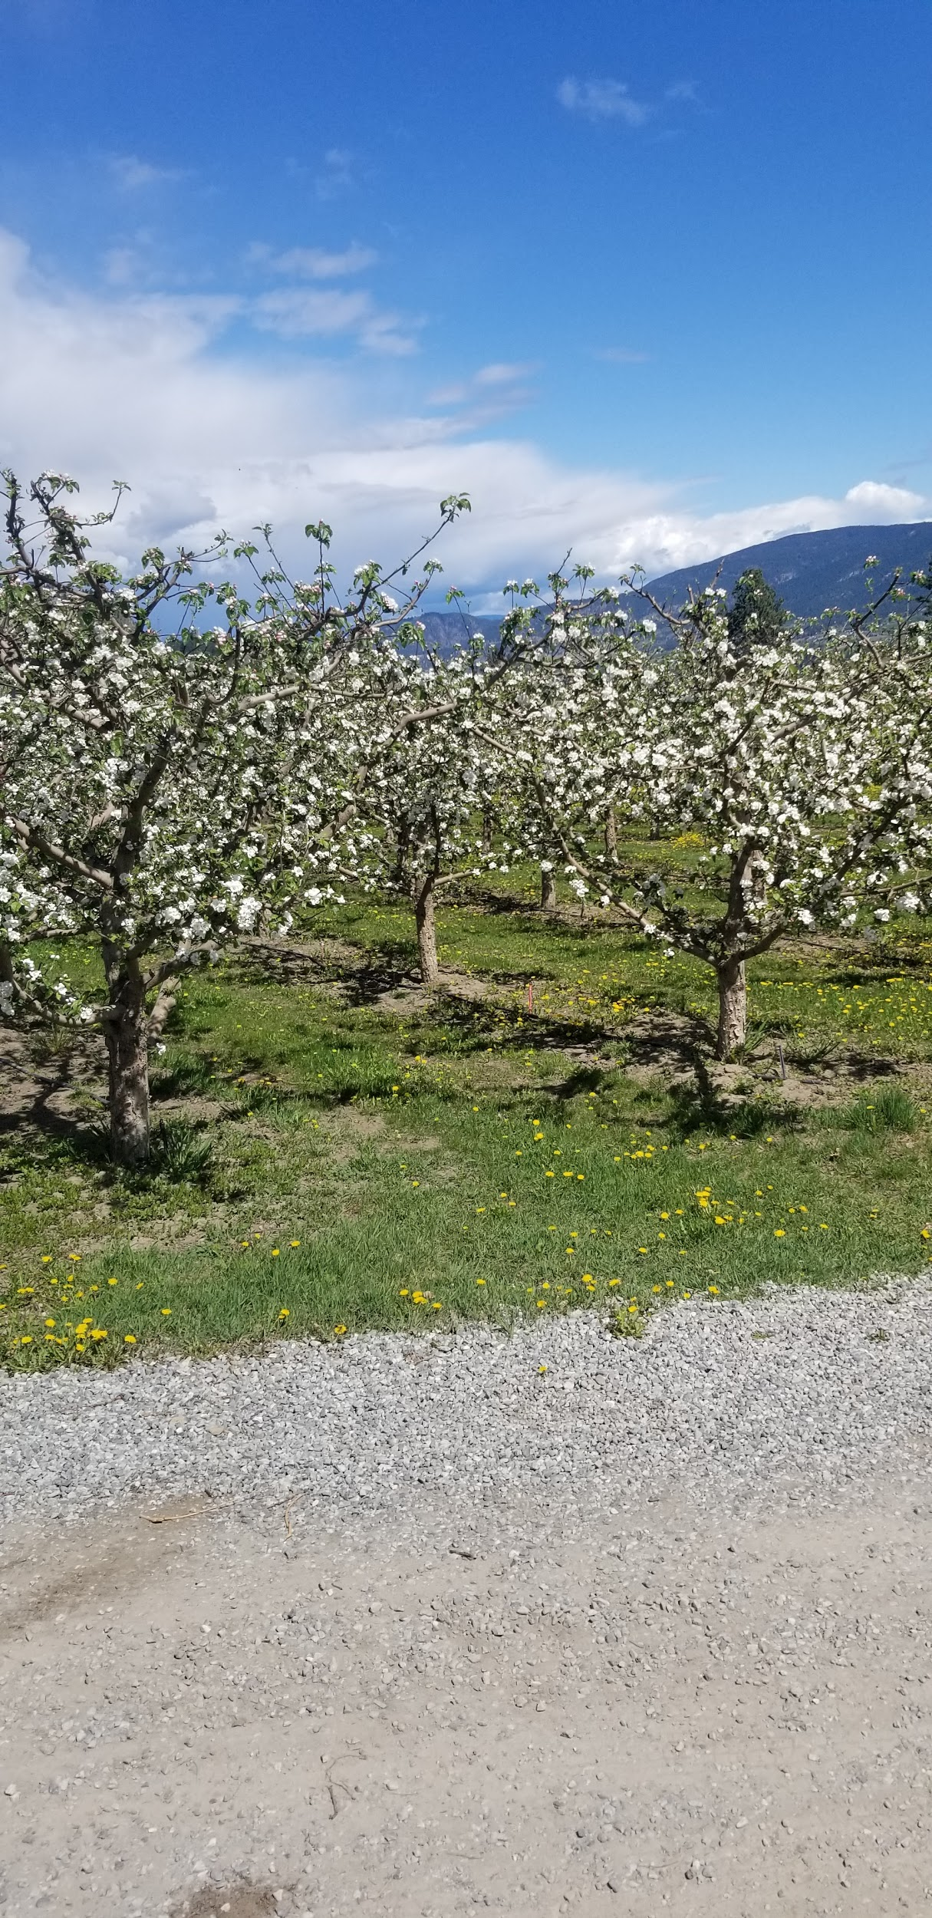
Rose Hill Orchard in Lake Country (2021)

Slide 14
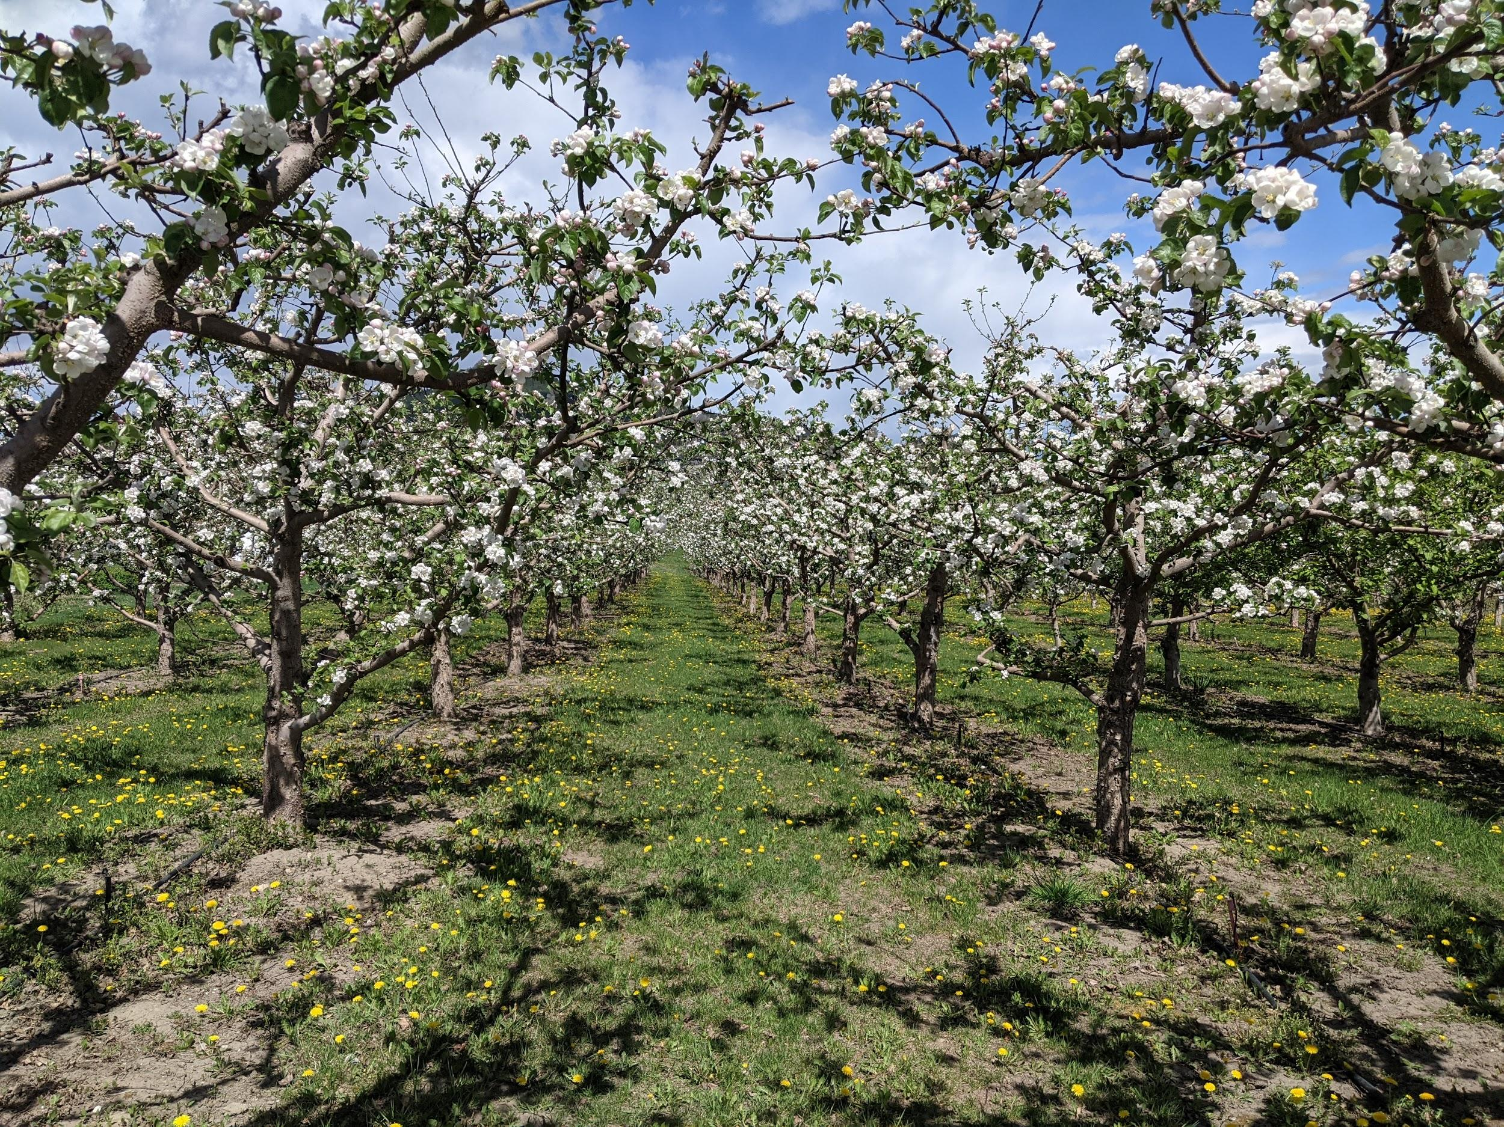
Rose Hill Orchard in Lake Country (2021)

Slide 15
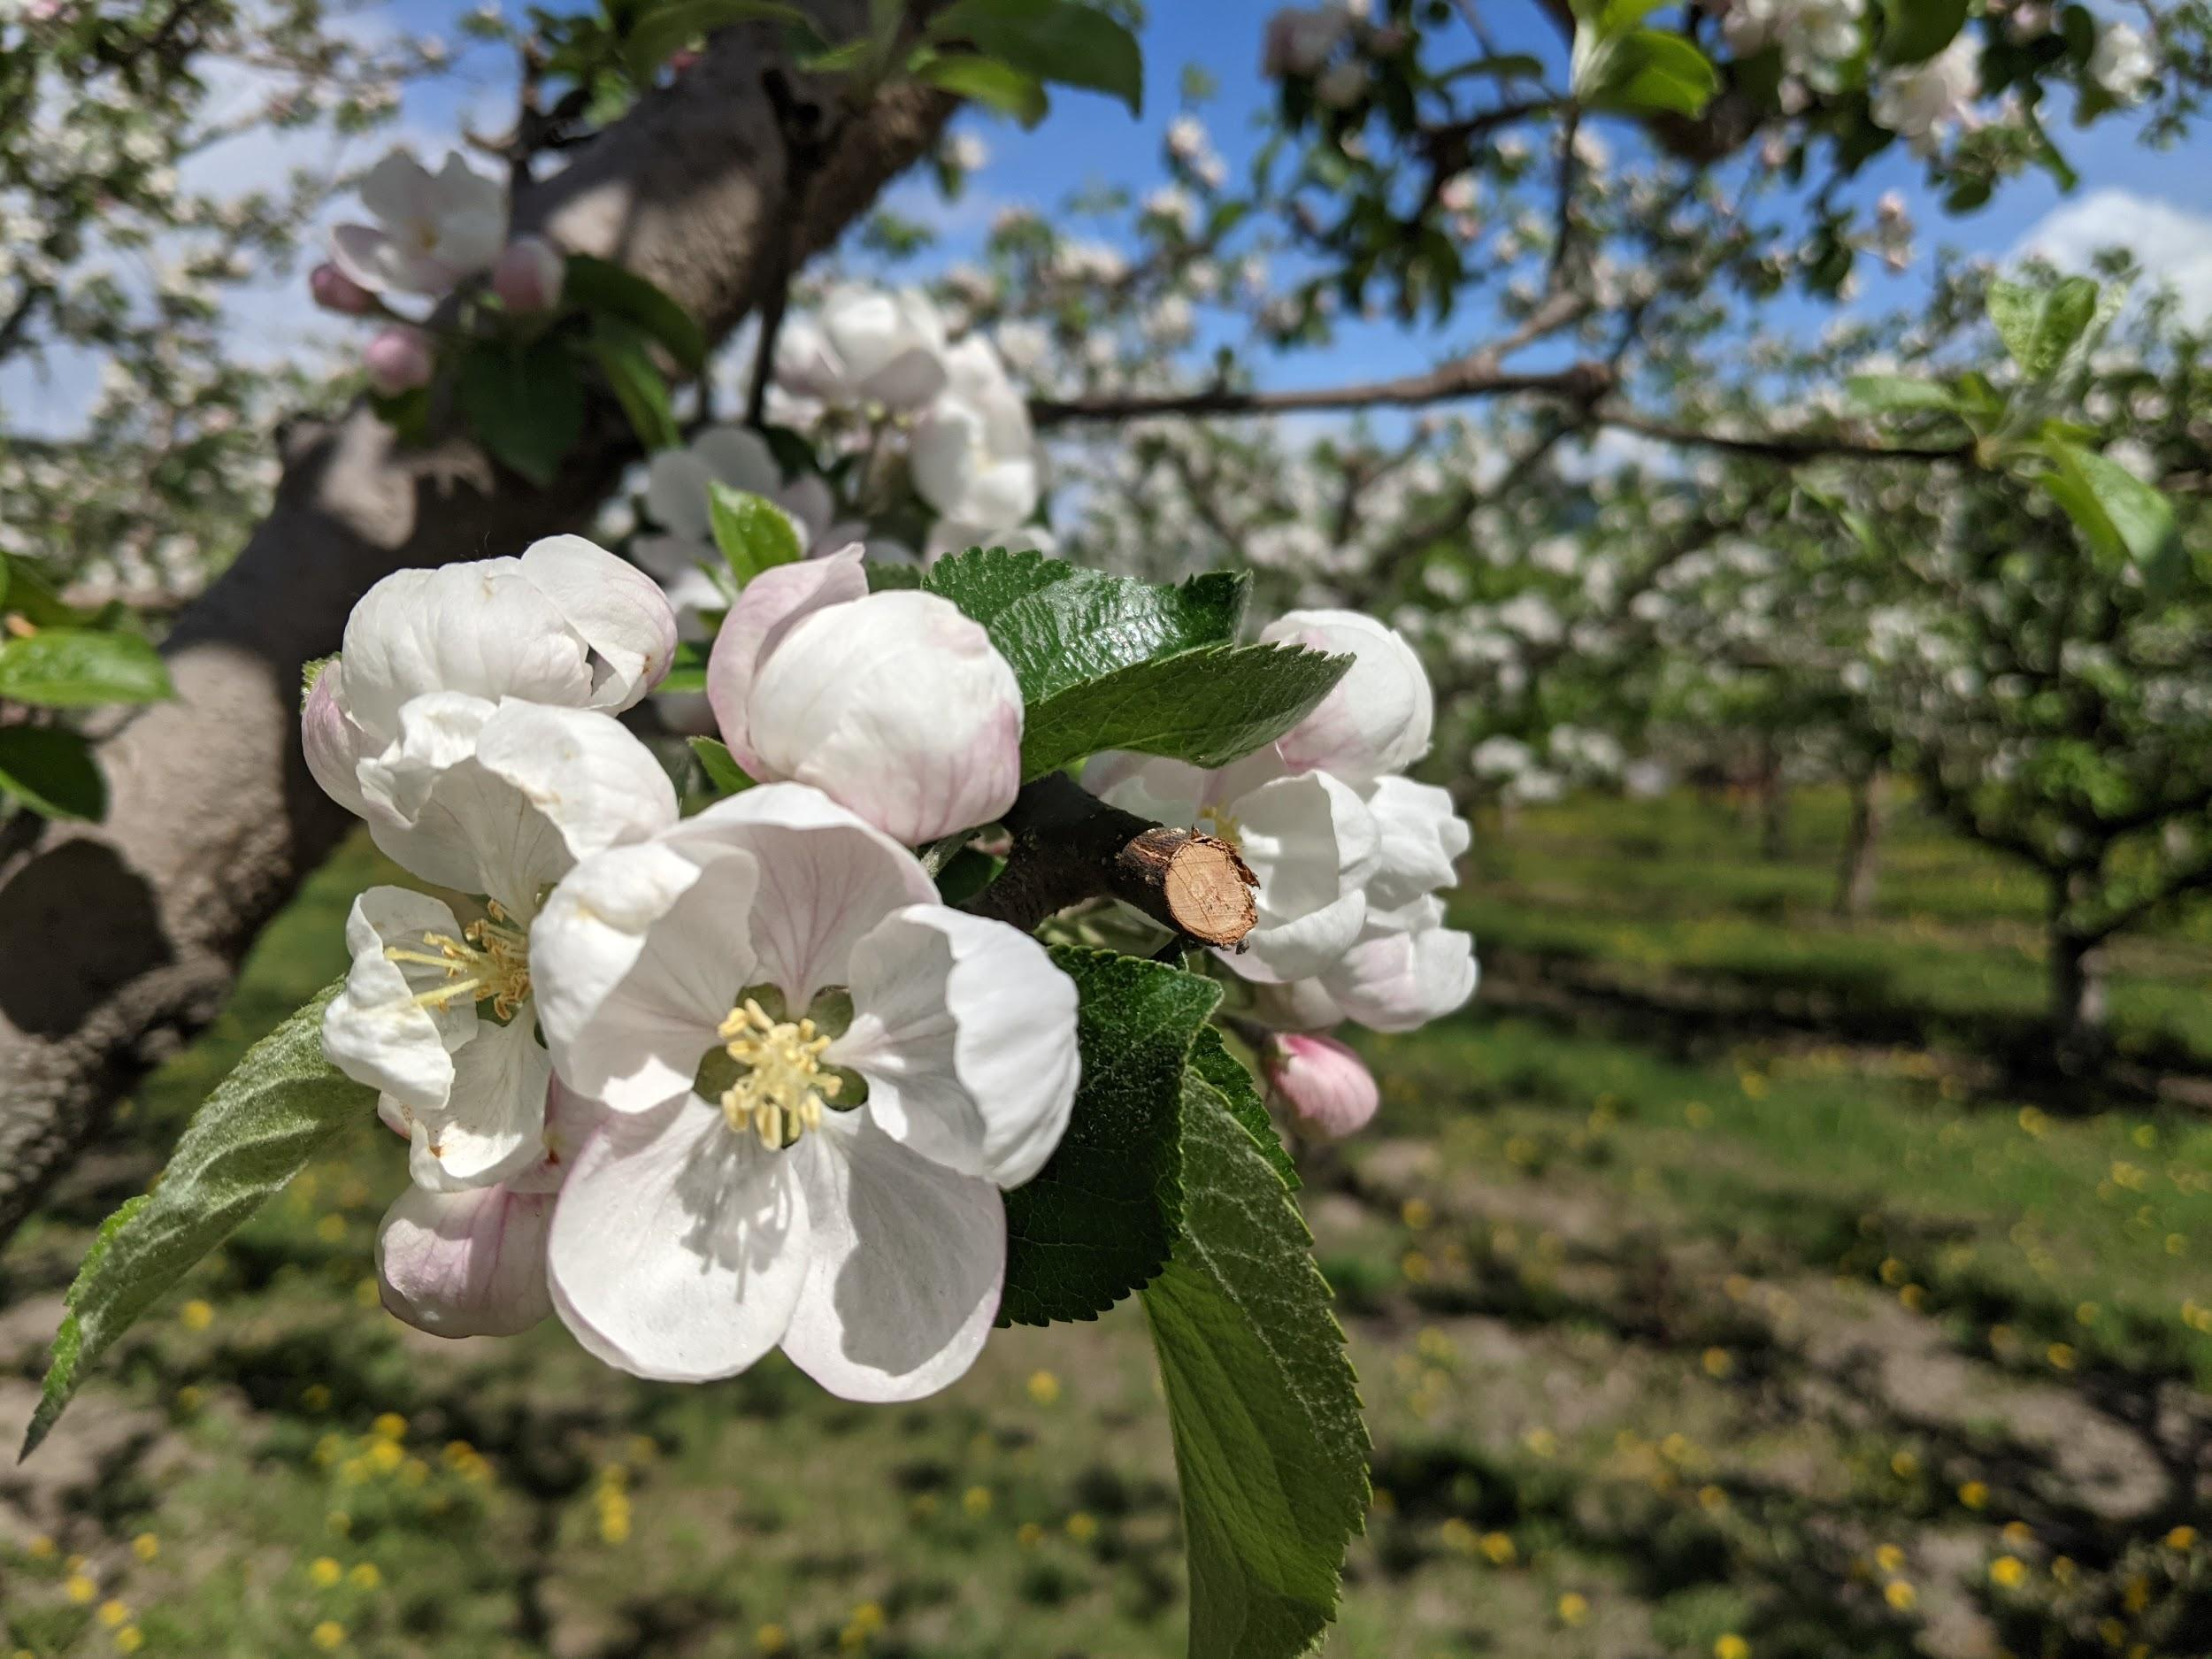
Rose Hill Orchard in Lake Country (2021) - Cherry Blossom

Slide 16
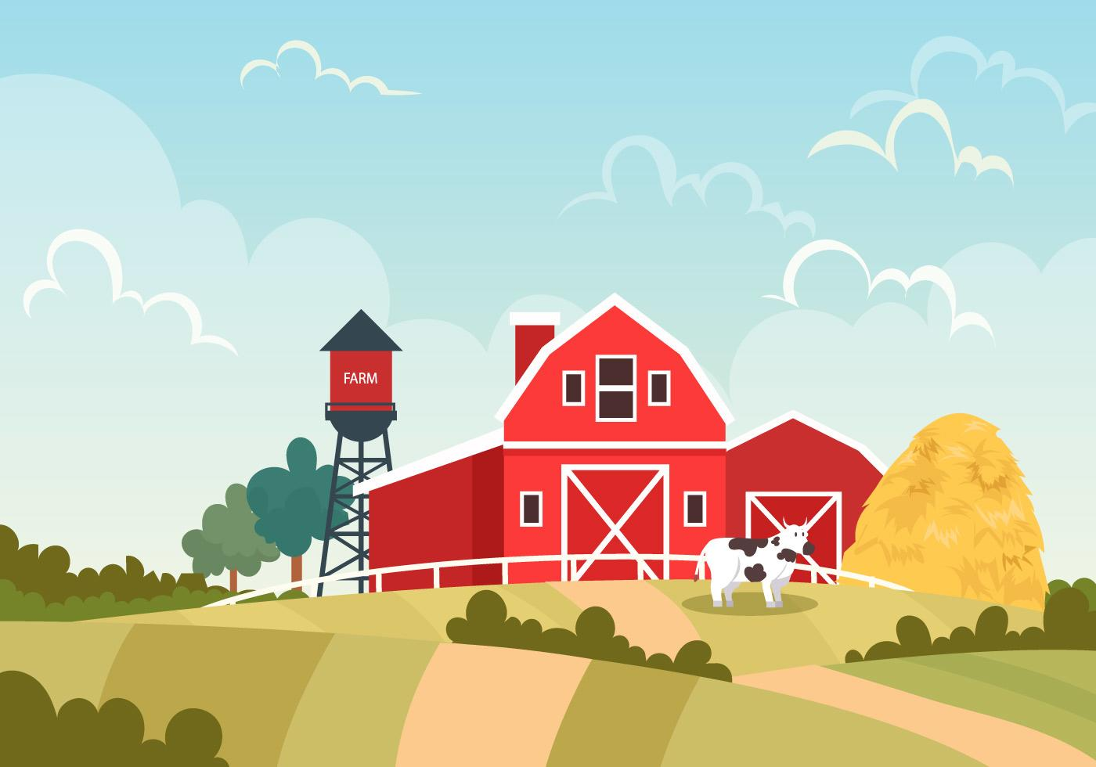
Create a farm
Using the materials given to you, make your own farm!
What does it look like?
What size is it?
What do you make at the farm?
Notes:
<a href="https://www.vecteezy.com/free-vector/nature">Nature Vectors by Vecteezy</a>
<a href="https://www.vecteezy.com/free-vector/apple">Apple Vectors by Vecteezy</a>

Slide 17
Copyright © 2021
Lake Country Heritage and Cultural Society
11255 Okanagan Center Road West
Lake Country, BC V4V 2J7
All rights reserved. No part of this publication may be produced, stored in a retrieval system, or transmitted, in any form or by any means, electronic, mechanical, photocopying, recording, or otherwise, without prior written permission of the publisher.
https://www.vecteezy.com/

