Slide 1
Kikinee Fishing

Slide 3
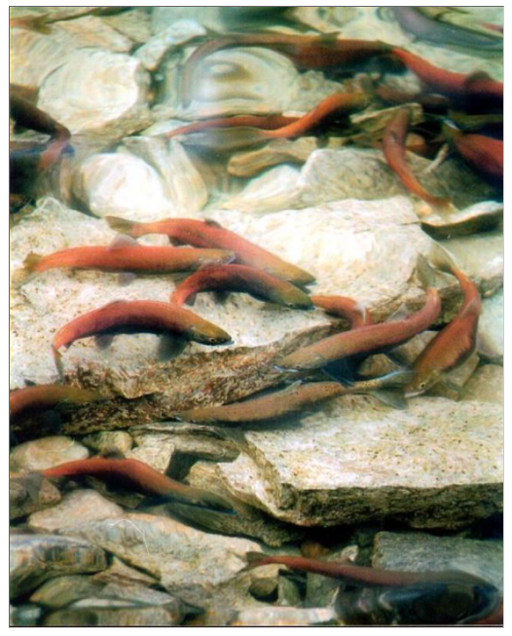
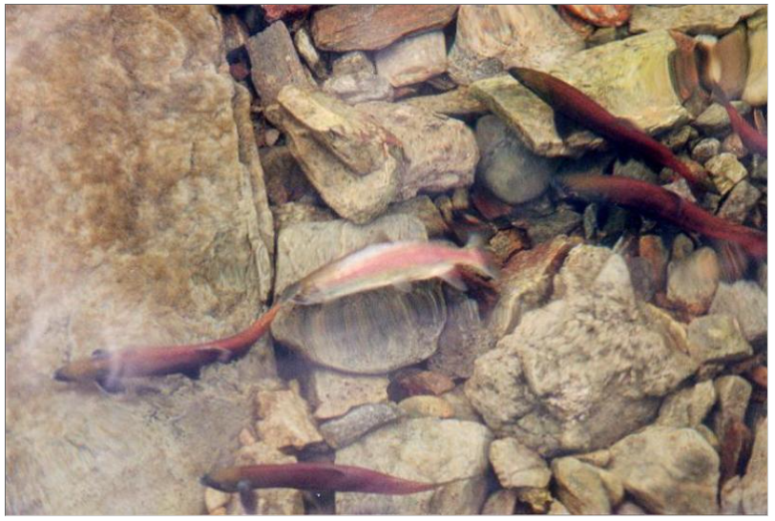

Slide 5
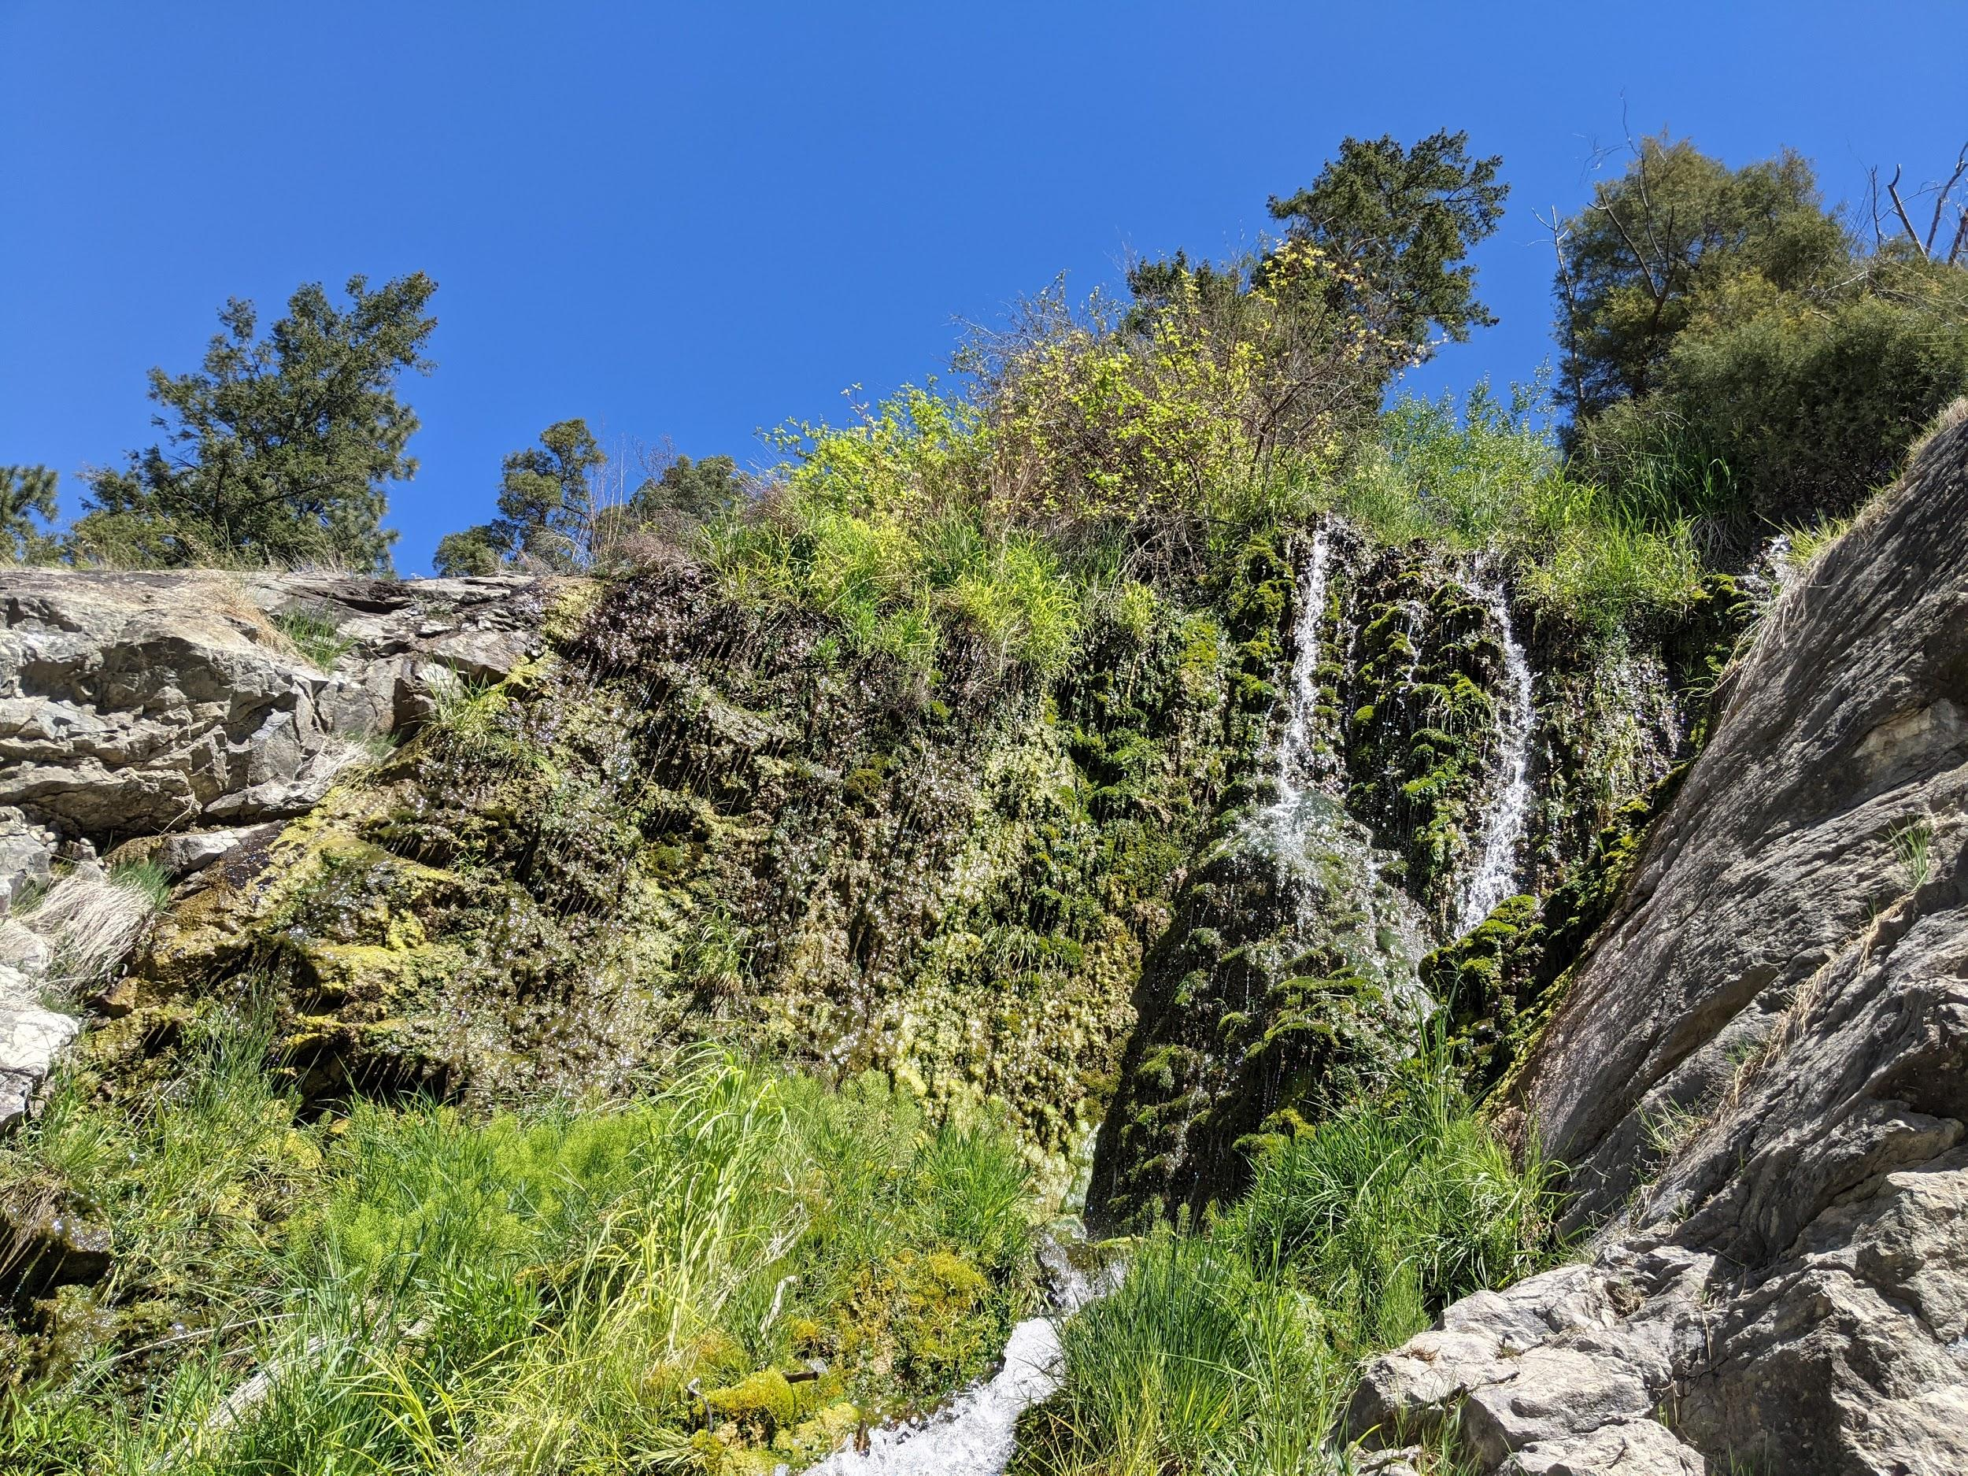
Ribbleworth Falls

Slide 6
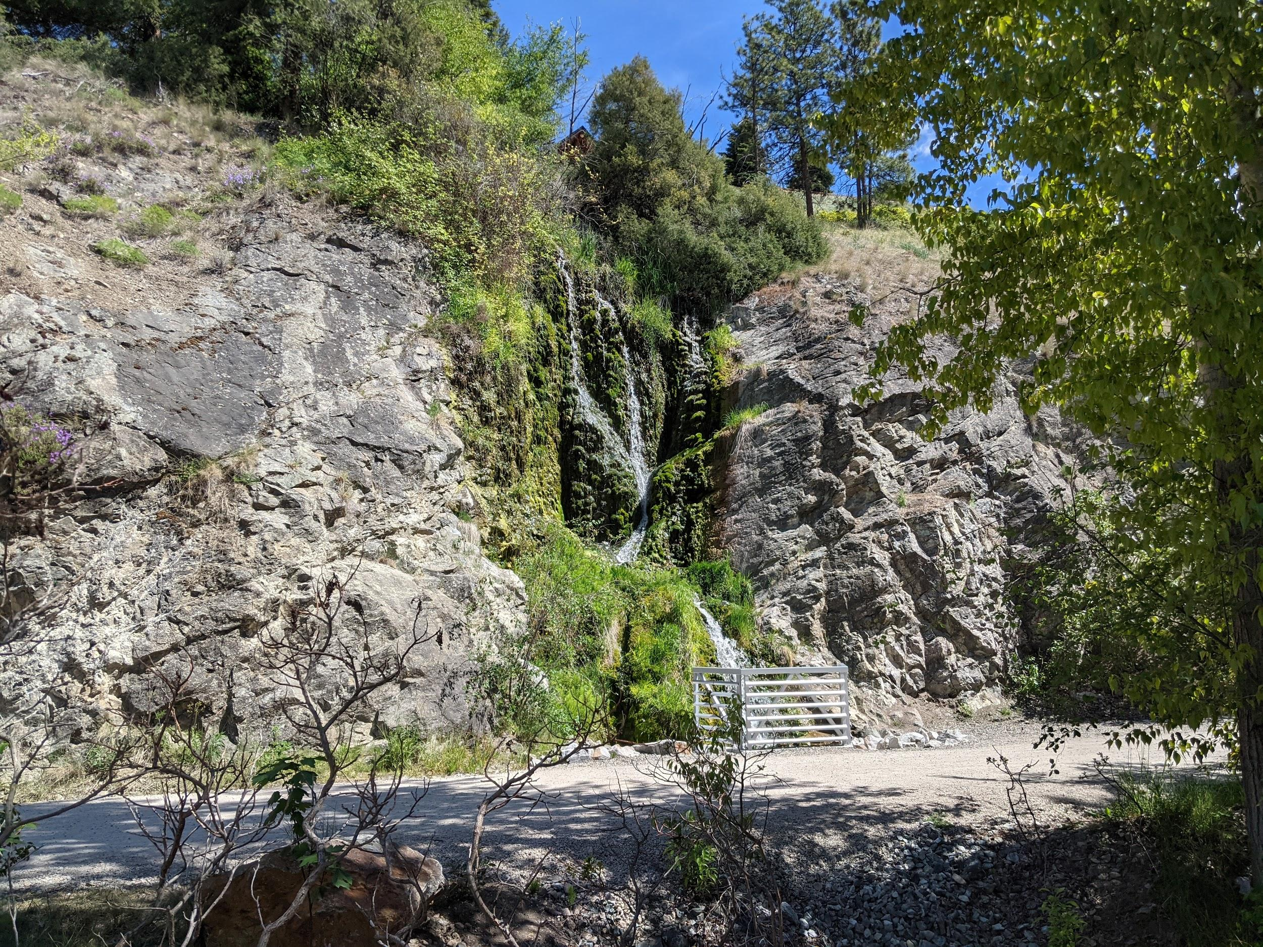
Ribbleworth Falls

Slide 7
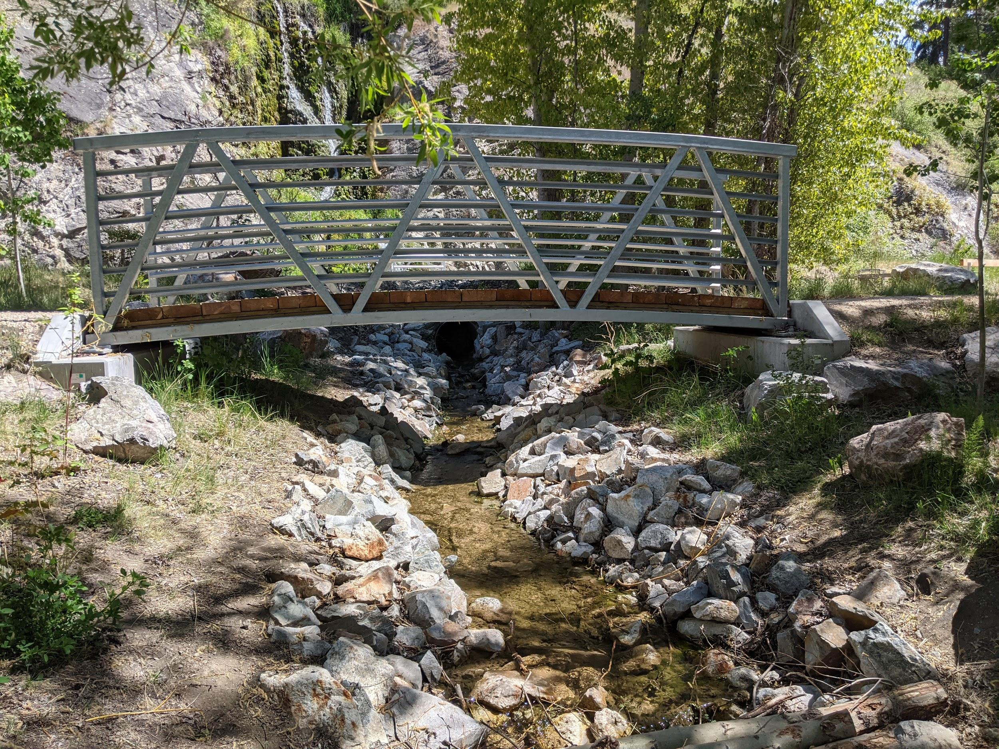
Ribbleworth Falls

Slide 8
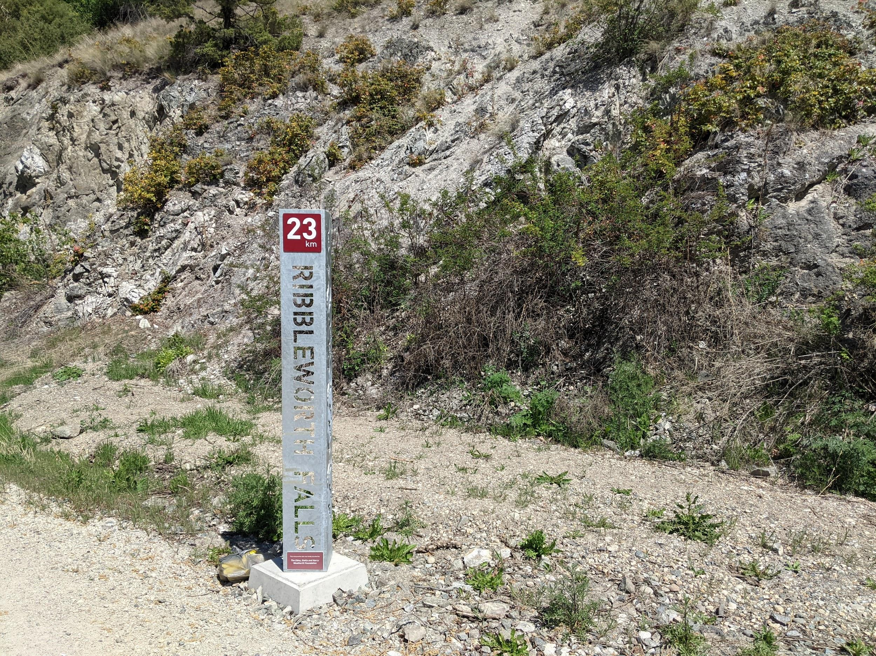
Ribbleworth Falls

Slide 9
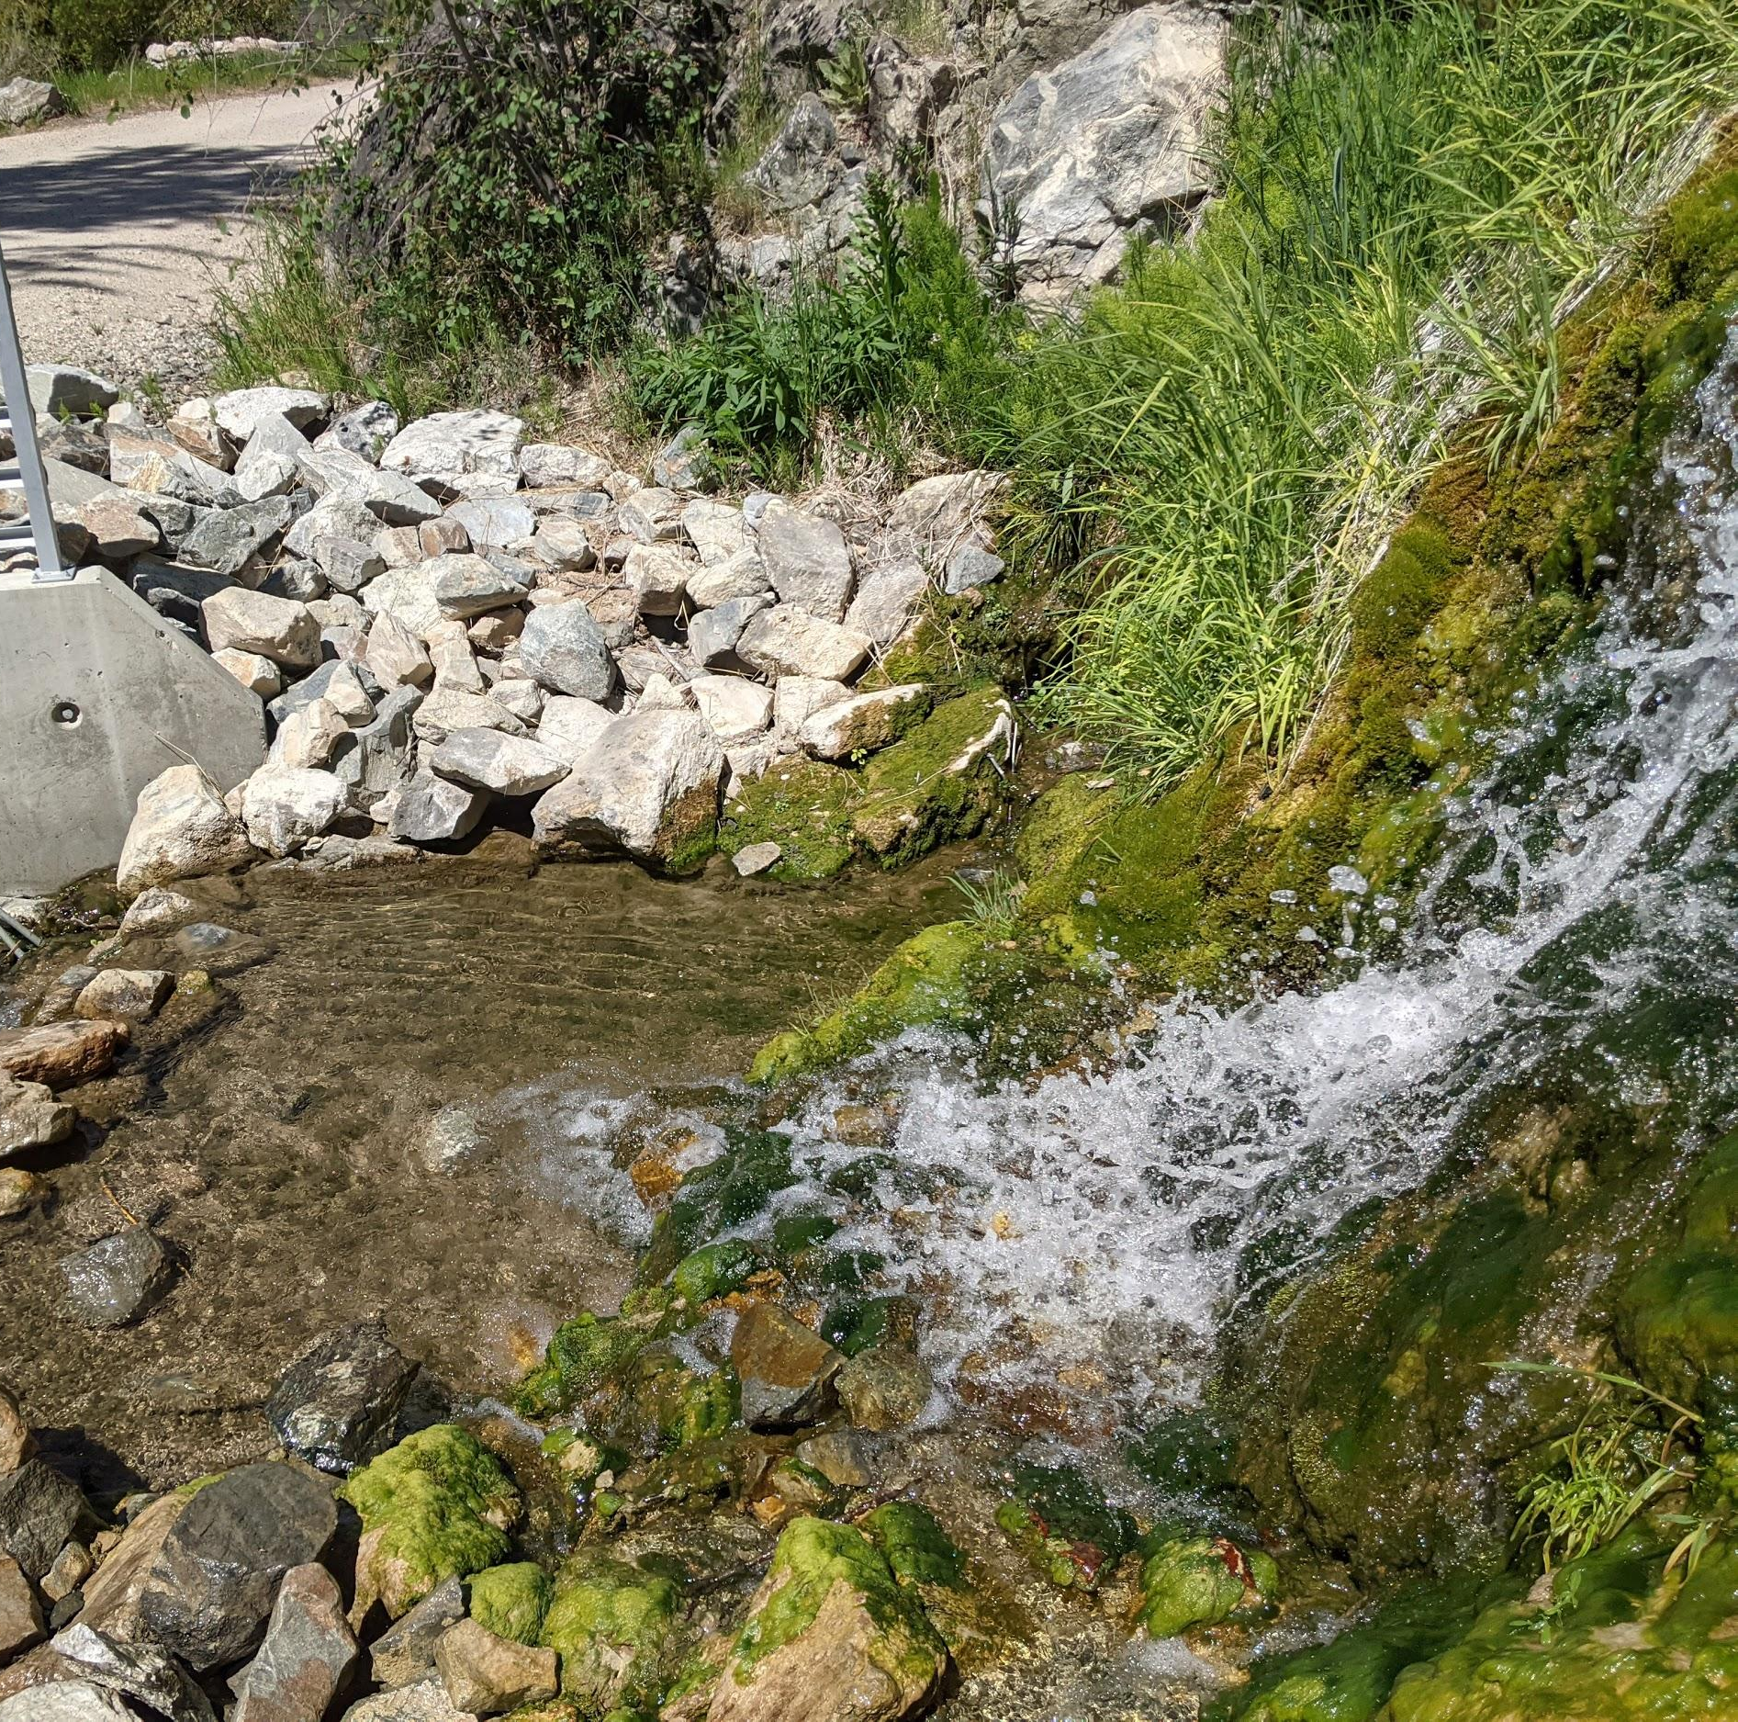
Ribbleworth Falls

Slide 10
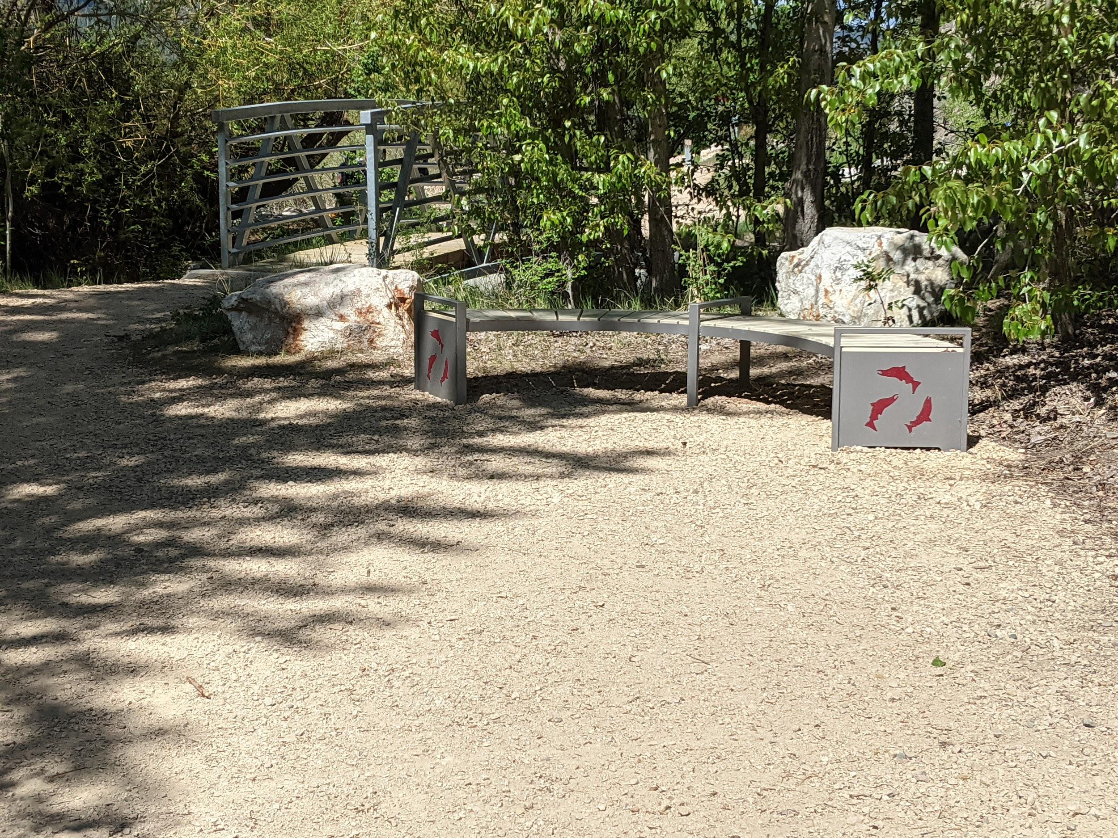
Ribbleworth Falls

Slide 11
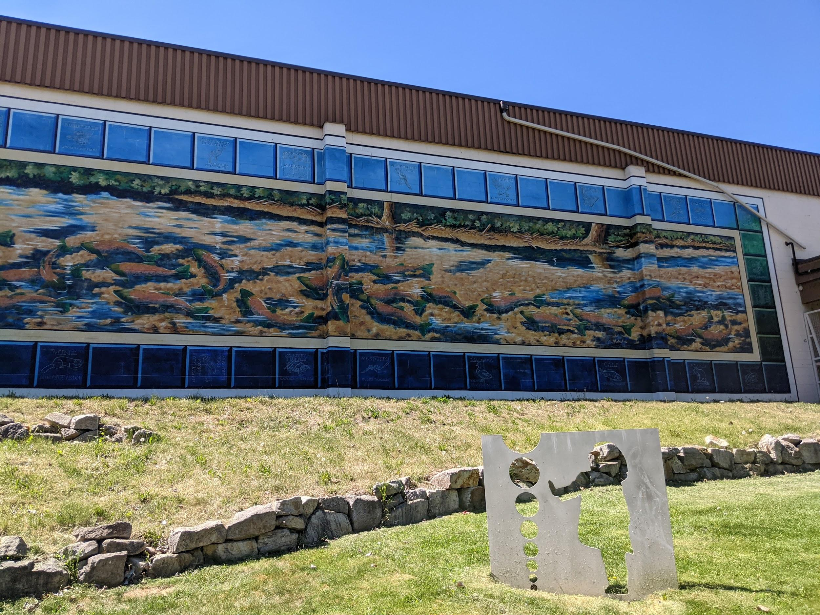
Artist: Don Makela

Slide 12
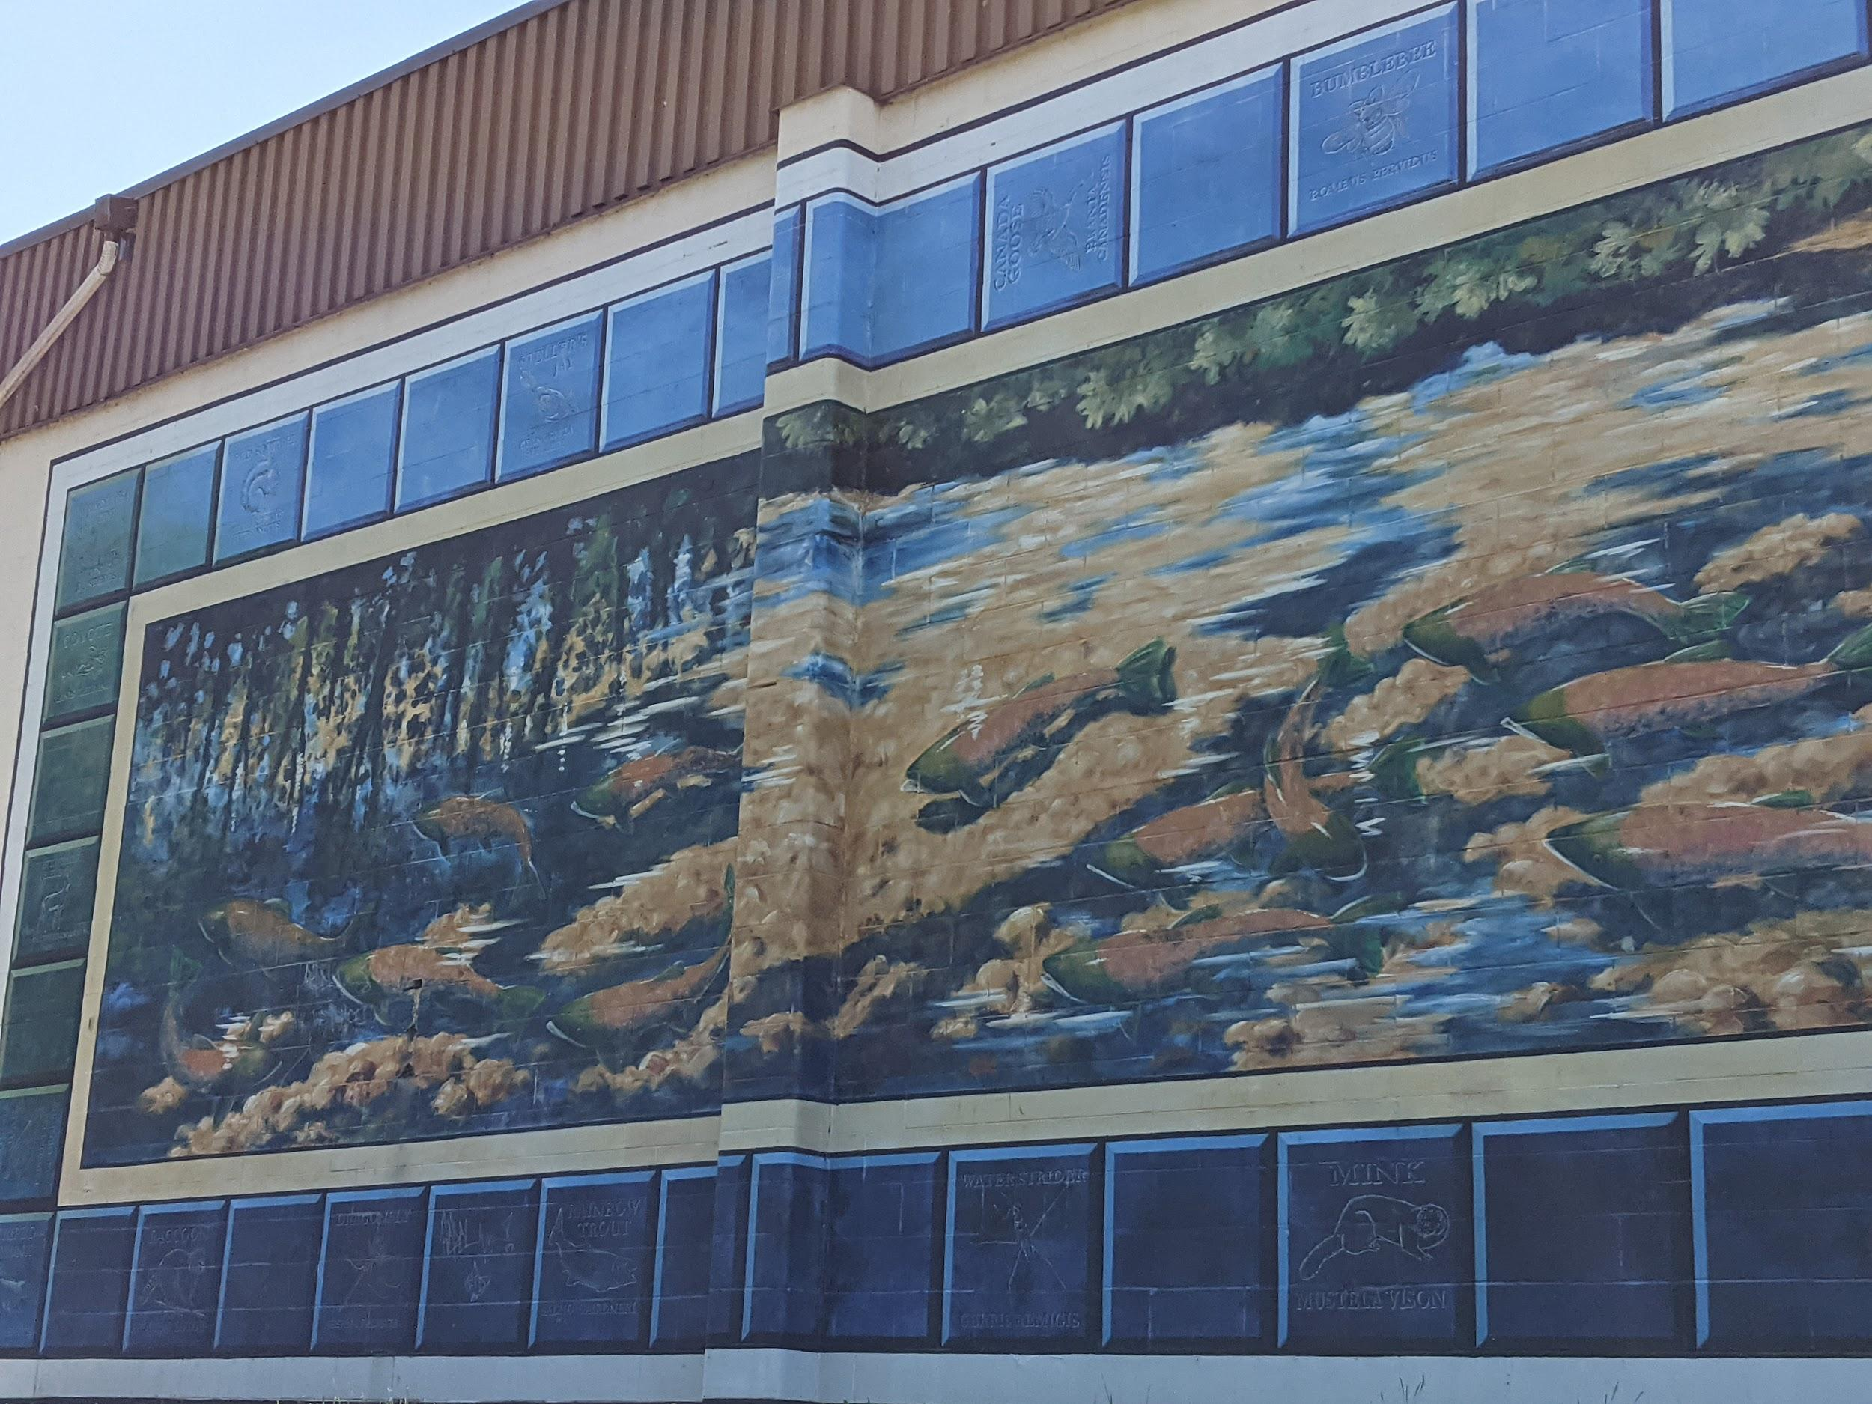
Artist: Don Makela

Slide 13
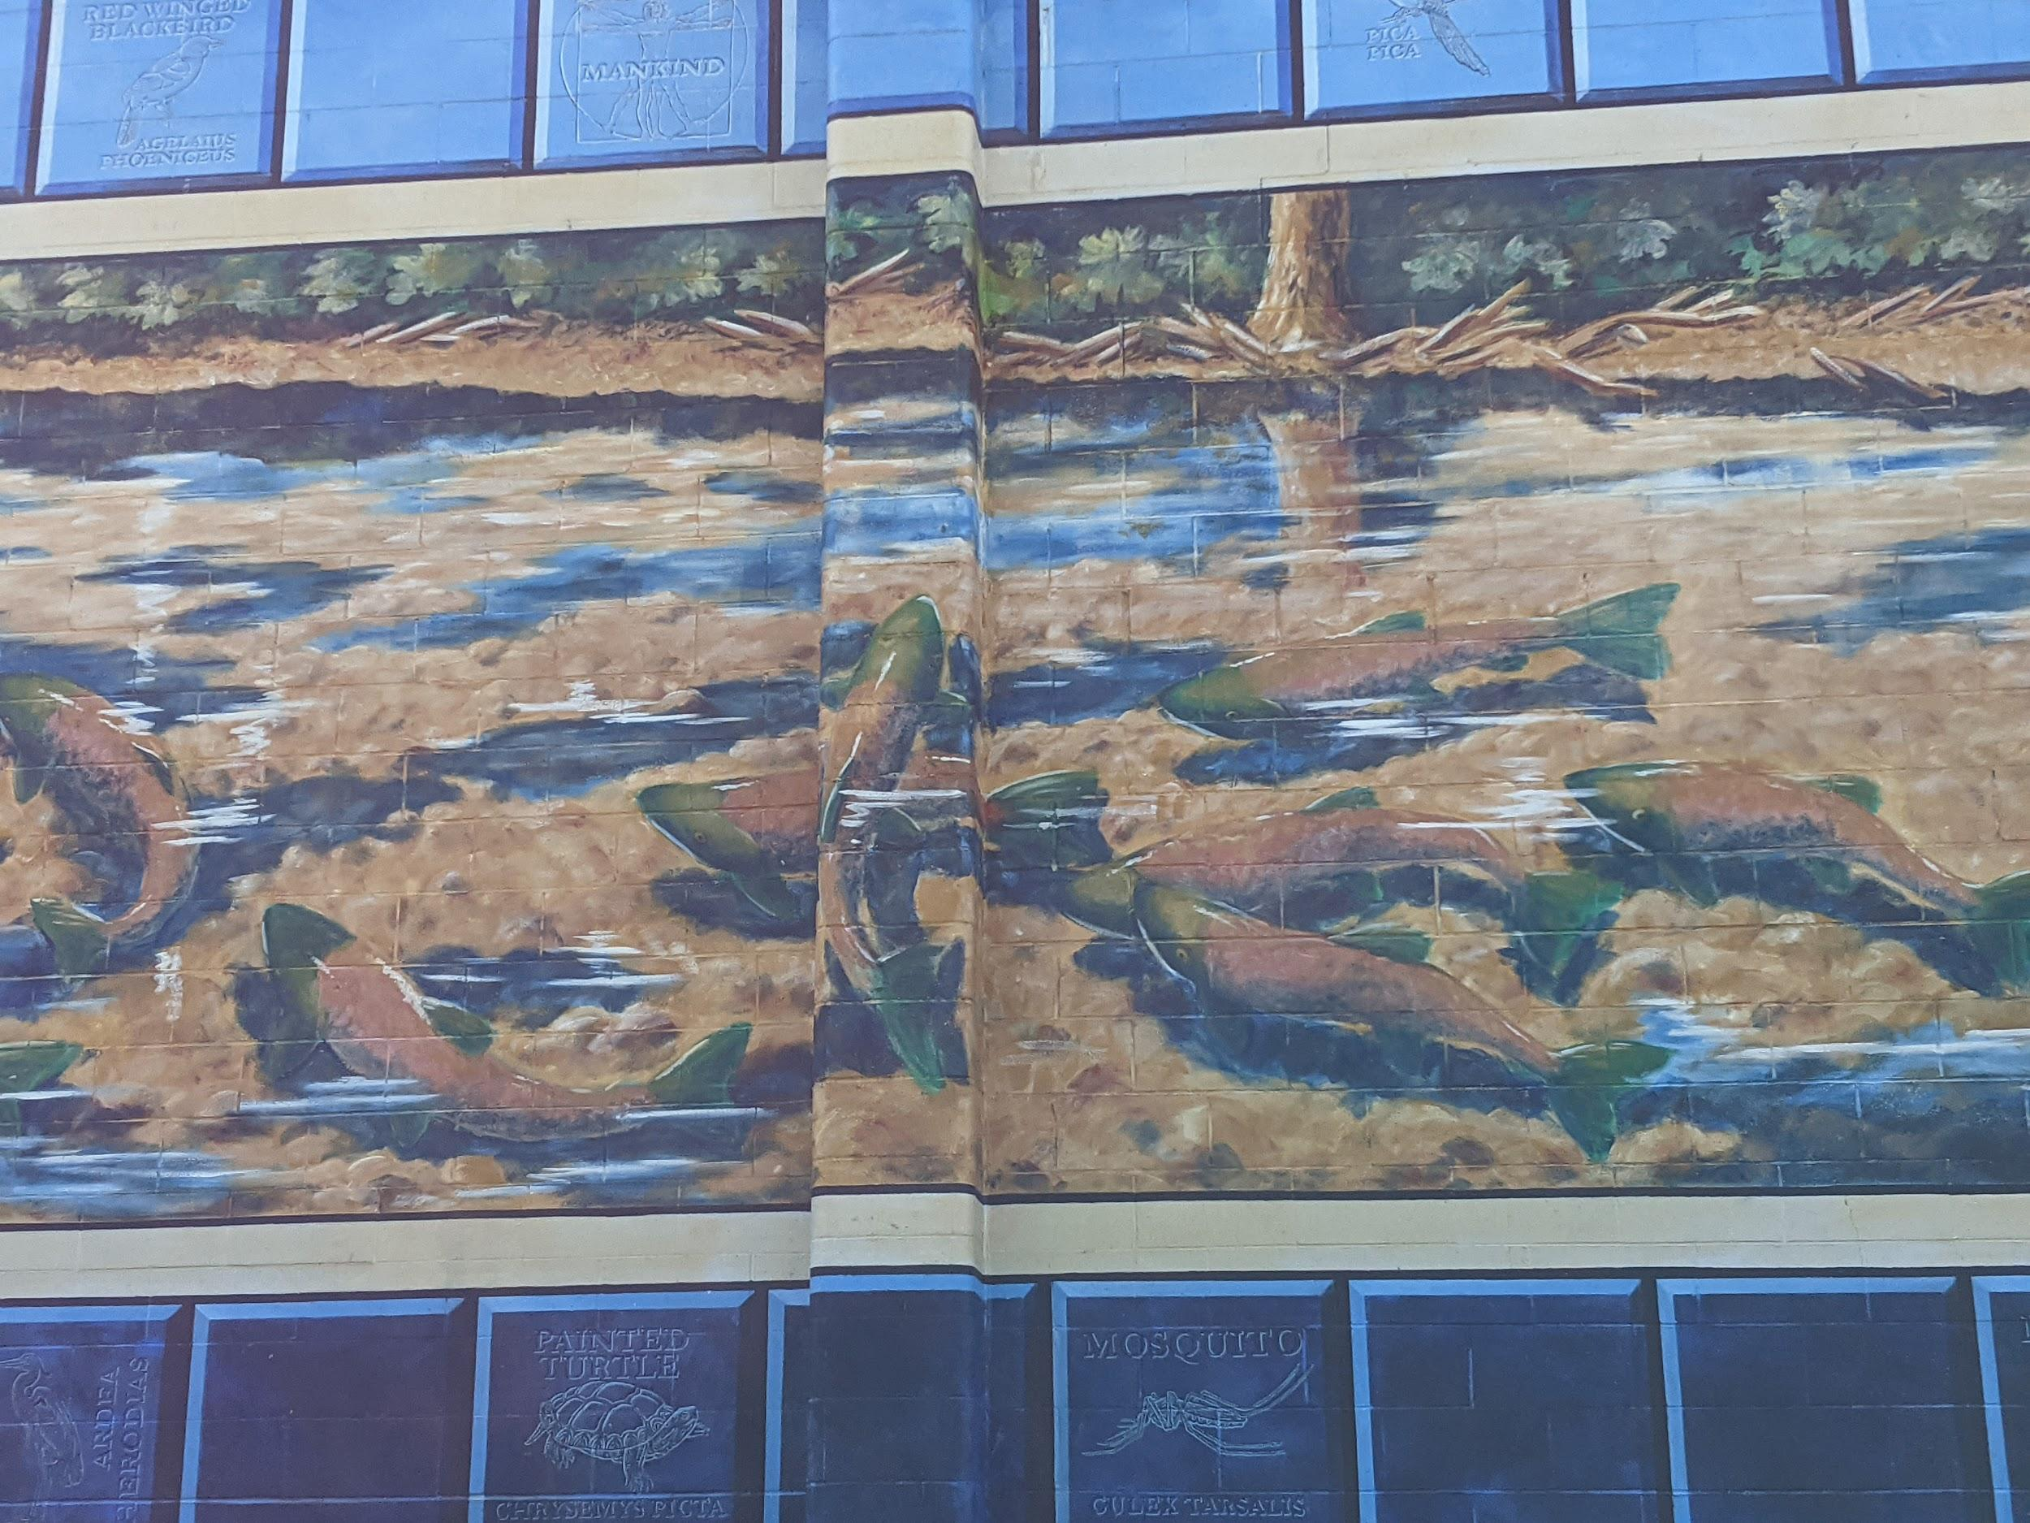
Artist: Don Makela

Slide 14
Copyright © 2021
Lake Country Heritage and Cultural Society
11255 Okanagan Center Road West
Lake Country, BC V4V 2J7
All rights reserved. No part of this publication may be produced, stored in a retrieval system, or transmitted, in any form or by any means, electronic, mechanical, photocopying, recording, or otherwise, without prior written permission of the publisher.
https://www.vecteezy.com/

